Slide 1


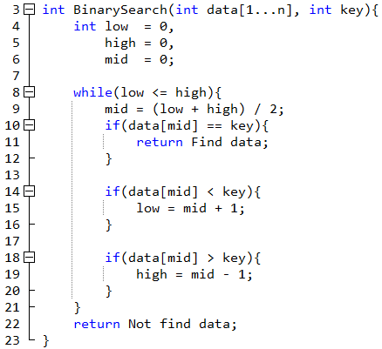
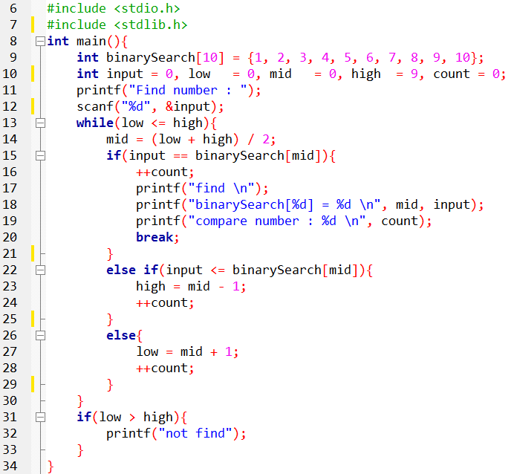
NDHU Department of Computer Science and Information Engineering
演算法實驗課程大綱

Slide 2

Assignment
Stage 1: forecast
Design the algorithm based on the given question and data structure, then analysis the algorithm for time and space complexity. The analysis of the complexity should include best and worst case. Please hand write your forecast on A4 size paper, and do not use pencil. Your forecast should include: (1) pseudocode (2) time complexity (3) space complexity. We accept flow chart, step by step statement and C-liked pseudocode as pseudocode

Slide 3

作業評分方式
Stage 2: coding
According to the algorithm you design write the code to solve the question. Send your code to online judge to see if you get accept.

Slide 4

作業評分方式
Stage 3: closure report
Closure report should include (1) screen shot of your result on online judge (2) your code (3) time complexity of your code (4) space complexity of your code. You also need to demo your closure report to TA.

Slide 5
作業繳交方式
For hand in your forecast to A316 with in the deadline.
Send your code to online judge.
Upload your closure report to E-Learning system.

Slide 6
評分標準
scoring
forecast: 20%
code: 40%
closure report: 40%

Slide 7



Slide 8


參考書目:

Slide 9



Slide 10
參考網頁
演算法筆記
連續30天挑戰演算法
初學者演算法
寫點科普，請給指教
MIT演算法開放式課程

